Slide 1
Sales Dataset Analysis
U.SARANYA
JUNE DADS & Cohort - B
08-08-2025

Slide 2
Project Objectives
Analyze sales data to identify trends and provide business insights.
Key Goals:
Analyze sales trends over time
Identify top-performing products
Evaluate discounts impact
Then we need Create an interactive dashboard for visualization of dataset

Slide 3
Data Description and Preparation
Dataset: 10,000 rows , fields: (Order ID, Product Type, Sales, etc.)
Data Cleaning:
Removed duplicates & blanks
Applied date formatting
Handled outliers & errors

Slide 4
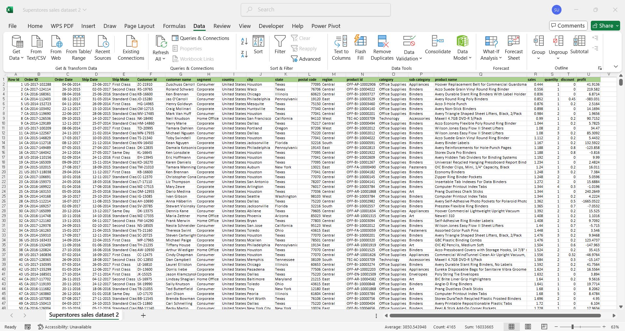

Slide 5
Key Metrics Calculation Data Analysis
Calculated Metrics:
Total Sales
Total profit
Average Order Value
Discounts & Returns Analysis

Slide 6
Pivot Tables and Pivot Charts
PivotTable Aggregations: Product Category, Sales , Time-based trends
Visualized trends using Pivot Charts (Bar & pie Charts)

Slide 7
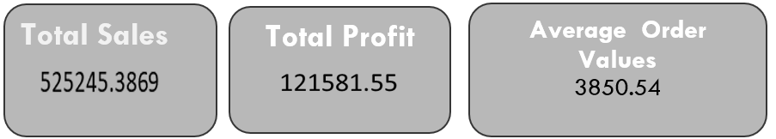
Dashboard Overview
KPIs: Total Sales, Total Profit, Average Order Value
Interactive Slicers: Category, Ship Mode, Segment
Date Range Selector

Slide 8
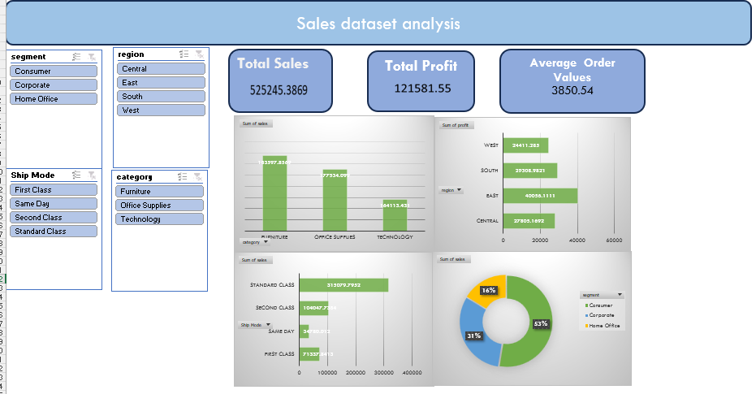

Slide 9
Conclusion
Comprehensive analysis using Advanced Excel techniques
Finally Dynamic dashboard created

Slide 10
THANK YOU

